Slide 1
Data Structures
Presenters
DINESH KUMAR BHONGIRI
VINAY PANJABI
November 17th, 2016

Slide 2
Overview
Basics of Data Structures
Stacks
Queues
Linked Lists
Trees
Definition
Diagram
Functions
Implementations

Slide 3
Basics of Data Structures
A data structure is a way of organizing data that considers not only the items stored, but also their relationship to each other.
Data Structures, on a broad scale can be classified as Simple Data Structures and Compound Data Structures.
Simple Data Structures are normally built from primitive data types like integers and characters.
Simple data structures can be combined in various ways to form more complex structures called compound datastructures.

Slide 4
Traversing through data elements of a data structure is the main purpose of using various data structures for different applications – making search efficient and easier.
Based on this criteria, data structures can be classified into two types as Linear data structures and Non-linear data structures.

Slide 5
In Linear data structures, if we traverse from an element, we can strictly reach only one other element.
Example - Stack, Queue, Linked List, etc.
In Non-linear data structures, traversing from an element can lead to more than one element. The data items are not arranged in a sequential structure.
Example – Trees, Graphs, etc.

Slide 6
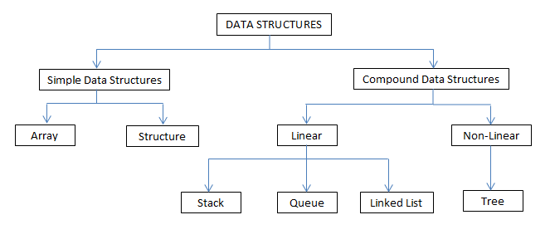
Classifications of Data Structures

Slide 7
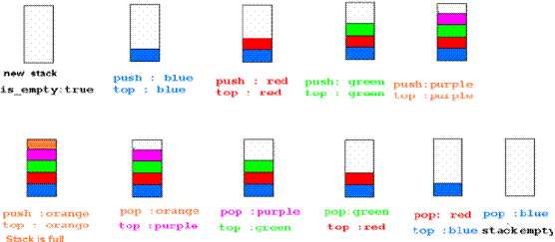
Stack
Stack is an Abstract Data Type(ADT), and is a specialized data storage structure that uses LIFO.

Slide 8
Functions and Implementations of Stack
createStack
Top
Insert
Delete
isFull
isEmpty
Array-based and Singly linked-list implementations
Implementations:
Parsing
Recursive functions
Expression Evaluation and Conversions.

Slide 9
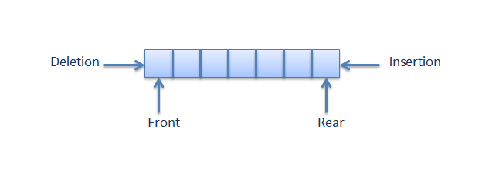
Queue
Queue is an Abstract Data Type(ADT) that follows FIFO. It is a collection in which entities kept in order are inserted from the rear end (enqueue) and retrieved from the front end (dequeue).

Slide 10
Functions and Implementations of Queue
createQueue
enqueue
dequeue
front
isFull
isEmpty
Implementations:
Operating Systems for processes
Computer Systems for message buffers, for messages between processes

Slide 11
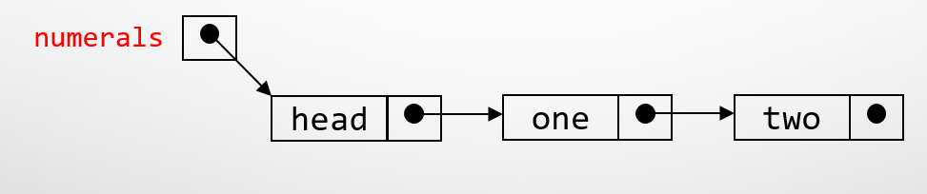
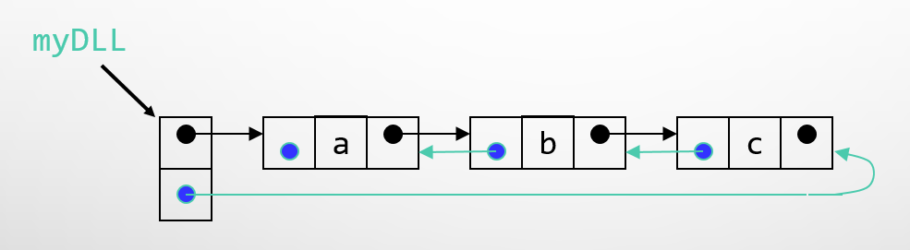
Linked List
Linked List is a sequence of data elements which are connected via links.
Types: Singly Linked List and Doubly Linked List

Slide 12
Functions and Implementations of Linked Lists
Adding elements: add, addAll, addFirst, addLast
Deleting elements: clear, remove(),removeFirst, removeLast
Retrieving elements: element(), get(), getFirst(), getLast(), indexOf(), lastIndexOf(), peek()

Slide 13
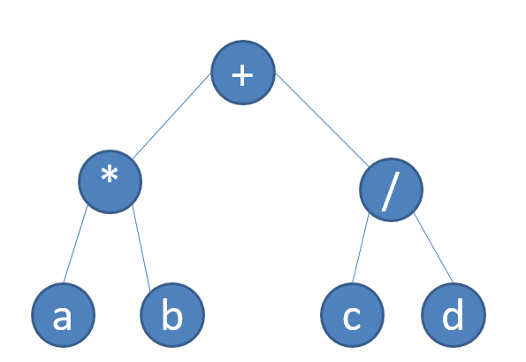
Tree
A Tree is a finite, non-empty set of elements used to represent hierarchical data.
A Binary tree is a tree having a root and remaining elements partitioned into 2 binary trees called left and right sub trees
Full Binary tree has all the nodes with 2 children except the leaf nodes.
Ex.: (a*b)+(c/d)

Slide 14
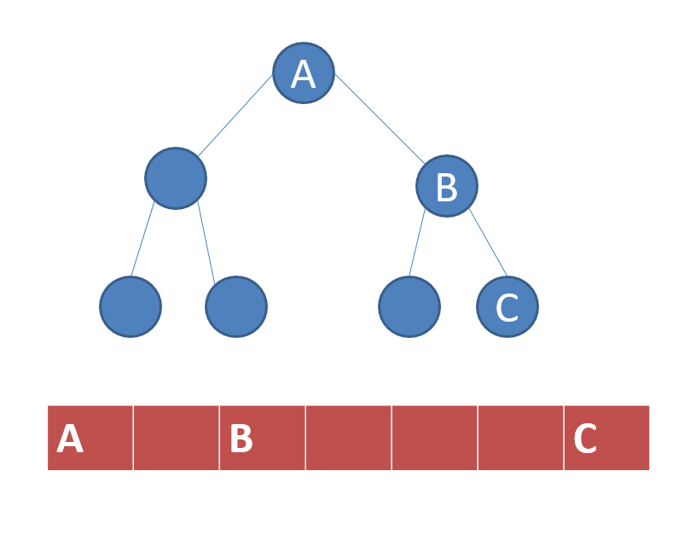
Array Representation of Binary Trees

Slide 15
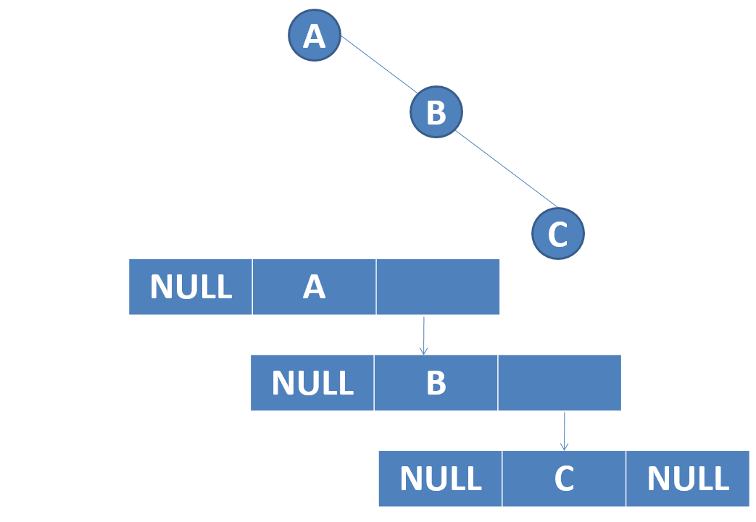
Linked List representation of Binary Tree

